Slide 1
SJSU CS 46A Introduction to Programming
When you come in
Open Canvas
Download Lesson22_student.zip
Join our class on iClicker after started

Slide 2
SJSU CS 46A Introduction to Programming
10.1 Using Interface for Algorithm Reuse
10.2 Working with Interface Types

Slide 3
public class UtilClass
{
public static double max(
Circle[] circleArray, int count)
{
double maxValue = Double.MIN_VALUE;
for (int i = 0; i < count; i ++)
{
double area = circleArray[i].area();
if (area > maxValue)
maxValue = area;
}
return maxValue;
}
. . . .
}

Slide 4
A Java Application Program
public class JavaApp
{
public static void main(String[] args)
{
Circle[] circleArray = new Circle[1000];
int count = 0;
// populating the array and update count
// Gets the largest area in circleArray
double max = UtilClass.max(circleArray, count);
. . .
}
}

Slide 5
Different Application Programs
BankAccount[] bankArray = new BankAccount[10000];
int numAccounts;
// Gets the largest balance?
double max = UtilClass.max(bankArray, numAccounts);
// NO!
Student[] studentArray = new Student[40000];
int numStudents;
// Gets the largest GPA?
double max = UtilClass.max(studentArray, numStudents);
// NO!
public static double max(Circle[] circleArray,
int count)

Slide 6
public class UtilClass
{
public static double max(
Circle[] circleArray, int count)
public static double max(
BankAccount[] bankArray, int count)
public static double max(
Student[] students, int count)
. . . .
}
Duplicated Code!
Same Algorithm on Different Classes.

Slide 7
What Do We Want?
Provide one method for one algorithm but for all classes
Treat different classes as one data type for the algorithm
Identify the required operations for the new type
Circle: area() returns a double
BankAccount: getBalance() returns a double
Student: getGpa() returns a double
An interface data type with one method that returns a double value
Notes:
People have found out: the required operations for the new type

Slide 8
Interface Data Types
Specify common operations
Declare an Interface type with abstract methods
Implement the interface in some classes
All such classes are treated as the interface type
Provide methods for the interface type
The methods can be applied to all classes that have implemented the interface type

Slide 9
Create an Interface in BlueJ
New Class
Select Interface for Class Type
"Interface" is a key word in Java
Name: Your choice (MyInterface)
Create abstract methods without bodies
Notes:
MyInterface: Two methods

Slide 10
One Method for Max Value of Arrays
BankAccount[] bankArray = new BankAccount[10000];
int numAccounts;
// Gets the largest balance
Student[] studentArray = new Student[40000];
int numStudents;
// Gets the largest GPA
Circle[] circleArray = new Circle[1000];
int count = 0;
// Gets the largest area
. . . .

Slide 11
public interface Measurable
{
/**
* Gets a measurable double value.
*
* @return a double value
*/
double getMeasure();
}
Abstract method, not stub.

Slide 12
iClicker Question #1
Which statement is incorrect about an interface data type?
An interface has no instance variables
An interface has no constructors
A method of an interface must be abstract
An interface can have only one method
Notes:
An interface can have multiple methods

Slide 13
An Interface Can Have Multiple Methods
Which statement is incorrect about an interface data type?
An interface has no instance variables
An interface has no constructors
A method of an interface must be abstract
An interface can have only one method
Notes:
An interface can have multiple methods

Slide 14
Class Circle
public class Circle
{
private double radius;
private int x, y;
// constructors
public double area()
{
return radius * radius * Math.PI;
}
// other methods
}

Slide 15
Implementing Interface Measurable
public class Circle
implements Measurable
{
. . .
public double area()
{
return radius * radius * Math.PI;
}
public double getMeasure()
{
return area();
}
}

Slide 16
Implementing Interface Measurable
public class BankAccount implements Measurable
{
private int accountNumber;
private double balance;
. . .
public double getMeasure()
{
return balance;
}
}

Slide 17
Implementing Interface Measurable
public class Student implements Measurable
{
private String id;
private double gpa;
. . .
public double getMeasure()
{
return gpa;
}
}

Slide 18
iClicker Question #2
Which statement is incorrect about implementing an interface data type?
You use the key word “implement” to specify a class to implement an interface
You must use “public” when implementing an interface method
You must implement all interface methods

Slide 19
Key Word implements
Which statement is incorrect about implementing an interface data type?
You use the key word “implement” to specify a class to implement an interface
You must use “public” when implementing an interface method
You must implement all interface methods

Slide 20
iClicker Question #3
Which statement in the following is incorrect? Remember we have implemented interface Measurable for classes Student and Circle.
Measurable var1;
Measurable var2 = new Measurable();
Measurable var3 = new Student("John", 3.5);
Measurable var4 = new Circle(0, 0, 4);
Measurable[] array = new Measurable[200];

Slide 21
Interface Variables and Objects
Which statement in the following is incorrect? Remember we have implemented interface Measurable for classes Student and Circle.
Measurable var1;
Measurable var2 = new Measurable();
Measurable var3 = new Student("John", 3.5);
Measurable var4 = new Circle(0, 0, 4);
Measurable[] array = new Measurable[200];

Slide 22
Class Student
public class Student implements Measurable
{
private String id;
private double gpa;
public Student(String name, double gpa)
public String getName()
public double getGpa()
public double getMeasure()
. . .
}

Slide 23
Calling Methods on Interface Variables
Measurable obj = new Student("Qi", 3.3);
double maxValue = obj.getMeasure();
// Yes
maxValue = obj.getGpa();
// No
String name = obj.getName();
// No
Student s = (Student)obj;
// Yes

Slide 24
public static double max(Measurable[] array,
int count)
{
double maxValue = Double.MIN_VALUE;
for (int i = 0; i < count; i ++)
{
Measurable obj = array[i];
double value = obj.getMeasure();
if (value > maxValue)
maxValue = value;
}
return maxValue;
}

Slide 25
public static double max(Measurable[] array,
int count)
Circle[] circleArray = new Circle[1000];
double maxArea = UtilClass.max(circleArray, count);
// Yes!
BankAccount[] bankArray = new BankAccount[100000];
double maxBalance = UtilClass.max(bankArray,
numAccounts);
// Yes!
Student[] studentArray = new Student[40000];
double maxGpa = UtilClass.max(studentArray,
numStudents);
// Yes!

Slide 26
Summary
Use interface data types to make code more reusable
An interface data type defines required methods
Abstract methods without body
An interface has no instance variables, no constructors, and no objects of the interface can be created
Multiple classes can implement an interface
Public methods with implementation details
All classes that have implemented the interface can be treated as the interface data type
We ignore other interface members
Notes:
We ignore other interface members, e.g., static methods

Slide 27
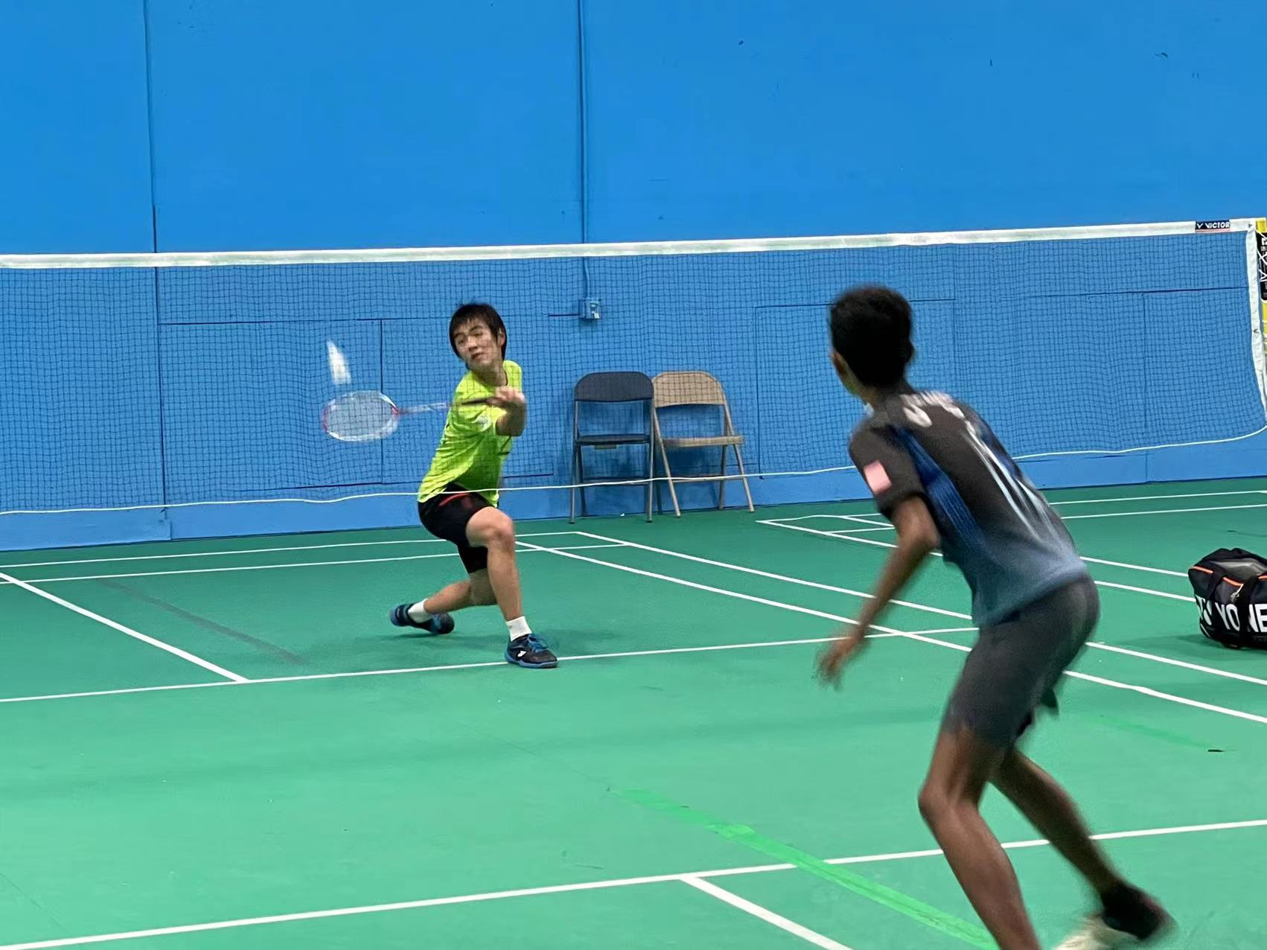

Slide 28
Participation Exercise Par22
Par22_A Codecheck link
https://www.codecheck.it/files/20111818223obl67mnpquumod4tuu41ax79
Par22_B Codecheck link
https://www.codecheck.it/files/20111906592sqmwx8ol89p75y0yvzhfcy45
Qualifiable, BankAccount, and Student are the same

Slide 29
Breakout room when possible
Main room: Par21 and otjers
My Office Hour: 8 – 9 pm

